Slide 1



Online Retail Customer Analysis: Insights for Growth
This analysis covers retail data with nearly 800,000 transactions from almost 6,000 customers. We'll explore key segments and opportunities.

Slide 2

Our Customer Base Overview
5,942
Unique Customers
Across multiple countries
44,876
Total Invoices
Throughout analysis period
10M+
Products Sold
Wide product range
$16.3M
Total Revenue
Generated during period

Slide 3



The RFM Segmentation Approach
Monetary
How much they spend
Frequency
How often they purchase
Recency
How recently they purchased
This approach helps us identify our most valuable customers and those who need attention.

Slide 4
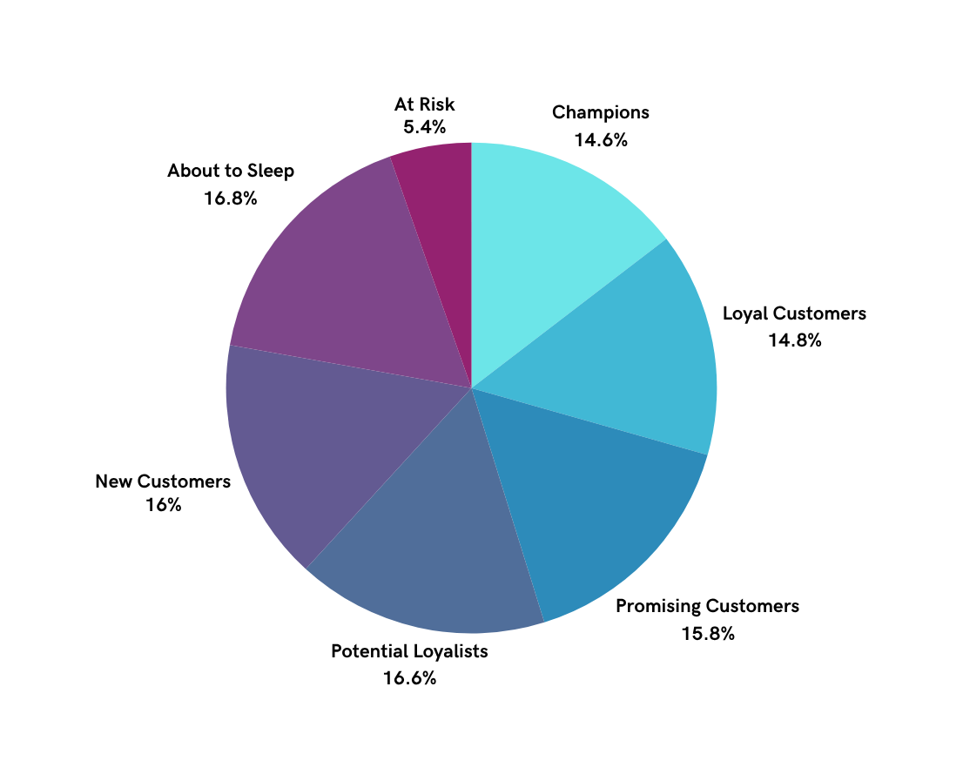
Customer Segment Distribution
High value
Champions | Recent purchases, frequent buyers, high spenders
Loyal Customers | Regular buyers with above-average spending
Promising Customers | Recent customers with potential to become loya
Potential Loyalists | Active but not frequent customers
New Customers | First-time or recent buyers
About to Sleep | Haven't purchased recently, risk of losing them
At Risk | Haven't purchased in a long time
Low Value

Slide 5
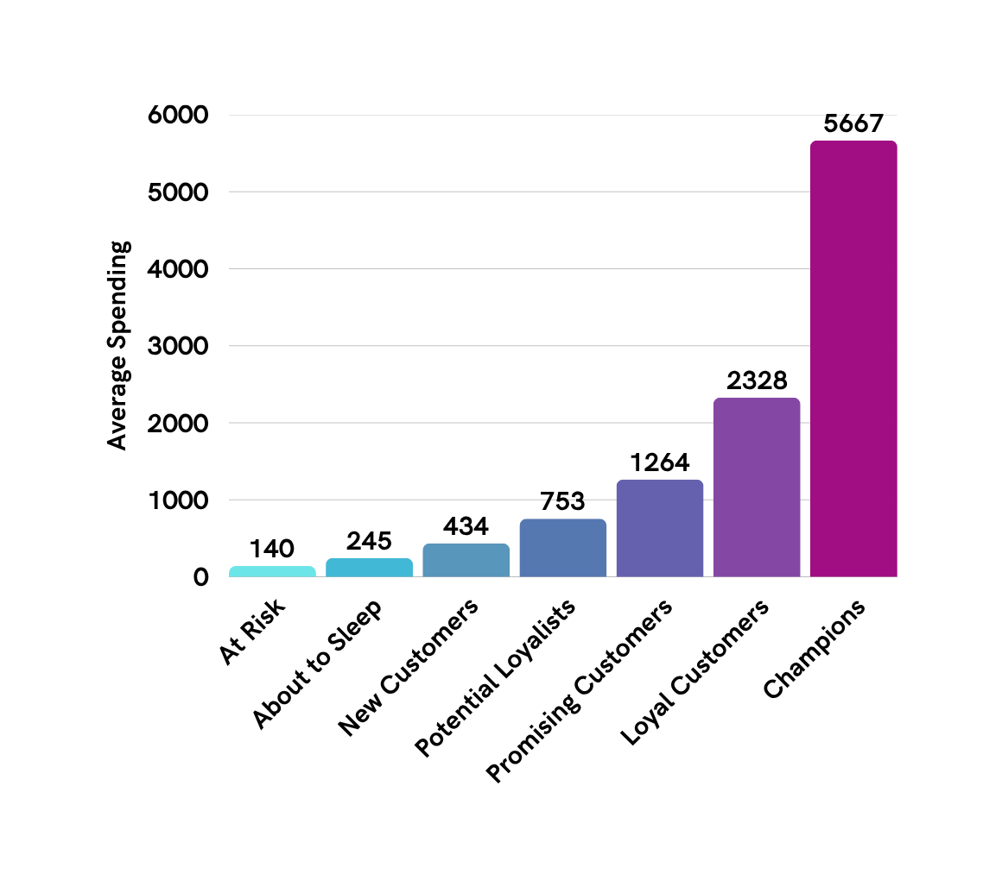

Value Distribution By Segment
Champions (14.6% of customers) generate over 51% of our revenue

Slide 6
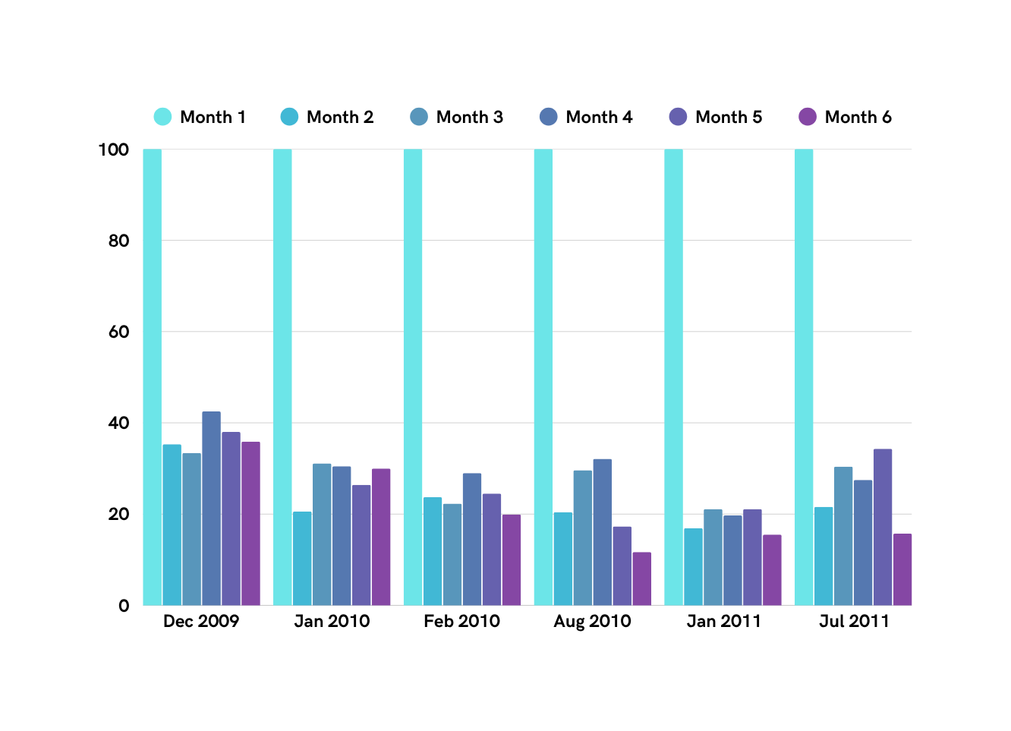
Customer Retention Patterns
Initial Drop-off
Strong drop-off after first purchase across all customer cohorts.
December Anomaly
Dec 2009 cohort saw a unique Month 4 retention spike (42.5%), likely due to a re-engagement campaign or holiday effect.
Stable Retention
Dec 2009 cohort maintained steady retention from months 2–6, unlike others.
Loyal Core
25–30% of customers in strong cohorts continue purchasing after 6 months.
Top Performer
December 2009 cohort retained 40% of its customers even after 24 months.
30% Rentention Threshold

Slide 7

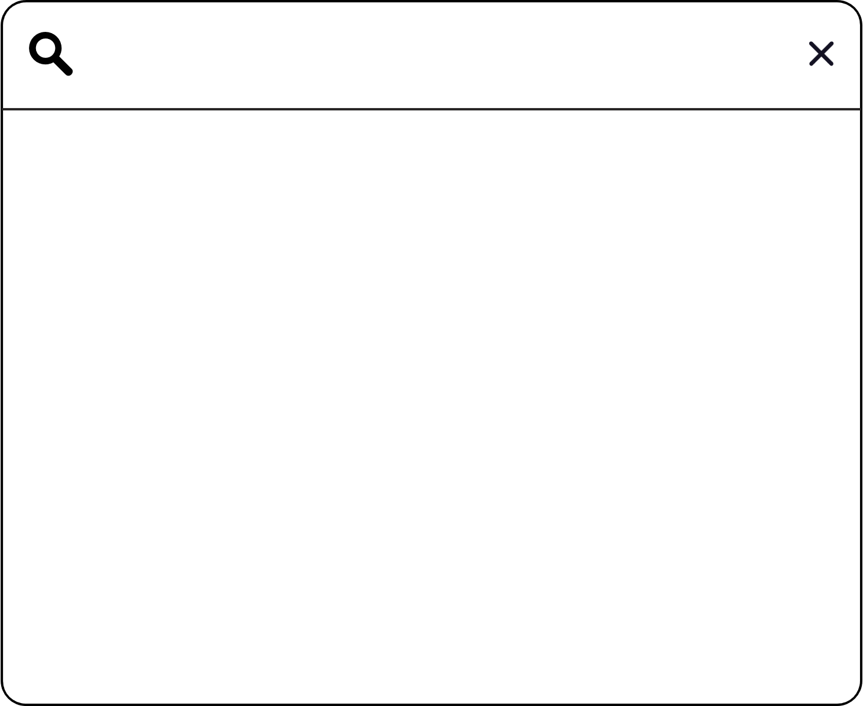
Recommended Action Plan
For Promising & Potential (32%)
For At-Risk & About to Sleep (22%)
For Champions & Loyal (30%)
Exclusive loyalty rewards program
Early access to new products
Personalized shopping experiences
Re-engagement email campaigns
Win-back category discounts
Customer feedback surveys
Targeted purchase incentives
Subscription offers
Educational product content

Slide 8


